Slide 1
RELATIONAL DATA MODEL AND SQL
INTRODUCTION TO DATABASES:
      Data models
      Relational database concepts
      Introduction to DDL & DML

Slide 2
DATA MODELS
Underlying the structure of a database is the data model:
A model shows the logical structure of a database
Data model: a collection of conceptual tools for describing data, data relationships and consistency constraints.
A model is a representation of ‘real world’ objects and events, and their associations.
it shows how data is stored, connected, accessed and updated in the database management system
Introduction to Database Languages

Slide 3
DATA MODELS
A data model can be comprising of three components:
A structural part, consisting of a set of rules that define how the database is to be constructed;
A manipulative part, defining the types of operations (transactions) that are allowed on the data
  includes the operations for updating or retrieving data and
  for changing the structure of the database;
A set of integrity rules, which ensures that the data is accurate.
Introduction to Database Languages
3

Slide 4
DATA MODELS
The purpose of a data model is to represent data and to make the data understandable.
If it does this, then it can be easily used to design a database
Provides basic notations and concepts that will allow database designers and end-users to unambiguously and accurately communicate their understanding of the organisational data.
Data modelling allows one to see the options provided by possible representations and to predict the effects of decisions.
Introduction to Database Languages
Notes:
The specific DDL of a given DBMS is used to write the schema; entity represented by a name, attributes and data types, constraints…data requirements.

Slide 5
DATA MODEL ...
If not done well, serious problems may arise later in the development process
Purpose: To represent data in an understandable way.
There are different database models which include:
  Relational
  Network and Hierarchical database models.
  ERD: mainly used in design
  Object based: Object oriented and object-relational
  Semi-structured e.g. XML
Introduction to Database Languages

Slide 6
CLASSES
There have been many data models proposed in the literature.
They fall into three broad categories:
  object-based, record-based, and physical data models.
The first two are used to describe data at the conceptual and external levels,
The third is used to describe data at the internal level.

Slide 7
THE THREE-LEVEL ARCHITECTURE
There are three distinct levels at which data items can be described
External level - The users’ view of the database.
  It describes that part of the database that is relevant to each user.
Conceptual level - The community view of the database.
  This level describes what data in the database and the relationships among the data.
  It contains the logical structure of the entire database as seen by the DBA.

Slide 8
THE THREE-LEVEL ARCHITECTURE…
Internal level - The physical representation of the database on the computer.
  This level describes how the data is stored in the database.
  It covers the physical implementation of the database to achieve optimal runtime performance and
  storage space utilization

Slide 9
OBJECT-BASED MODEL
Object-based data models use concepts such as entities, attributes, and relationships.
An entity is a distinct object (a person, place, thing, concept, event) in the organization that is to be represented in the database.
An attribute is a property that describes some aspect of the object that we wish to record,
A relationship is an association between entities.

Slide 10
OBJECT-BASED MODEL
The data model where data is stored in the form of objects.
Some of the more common types of object-based data model are:
  Entity-Relationship (ER)- the main techniques for database design
    It forms the basis for the database design methodology
  Semantic - designing database structures that focuses on capturing the meaning and relationships between data elements

Slide 11
OBJECT-BASED MODEL…
  Functional - a model that supports management analytics applications
  Object-oriented - a data modeling advancement that combines database and programming concepts
    Data is represented as objects, and
    relationships are established through object-oriented programming (OOP) techniques such as
    inheritance, encapsulation, and polymorphism.

Slide 12
OBJECT-BASED MODEL
The object-oriented data model extends the definition of an entity to include;
  The attributes that describe the state of the object
  The actions that are associated with the object, that is, its behavior
The object is said to encapsulate both state and behavior

Slide 13
RECORD-BASED DATA MODELS
In a record-based model, the database consists of;
  a number of fixed-format records, possibly of differing types.
Each record type defines a fixed number of fields,
  typically of a fixed length
Types of record-based logical data model: a
  the relational data model,
  the network data model, and
  the hierarchical data model.

Slide 14
RECORD-BASED DATA MODELS
The hierarchical and network data models - developed almost a decade before the relational data model,
Their links to traditional file processing concepts are more evident.

Slide 15
EXAMPLES OF DATA MODELS CONT’D
Physical Data Models
Present how data is stored in a computer e.g.
  structures of records.
Introduction to Database Languages

Slide 16
RELATIONAL DATA MODEL
A database structure that treats all of its data as a collection of relations
Data and relationships are represented as tables, each having uniquely identified columns
Based on mathematical relations
Example
  A company needs to store information on departments and employees.
  Each table contains data that describes exactly one entity - a thing of significance about which information needs to be known.

Slide 17
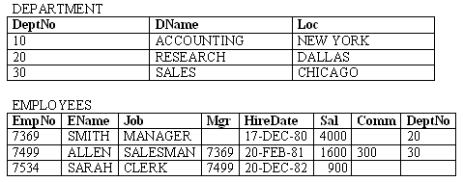
EXAMPLE OF A RELATIONAL DB

Slide 18
RELATIONAL DATA MODEL…
Note that there is a relationship between Employee and Department:
  a Department office has Employee.
However, there is no explicit link between these two tables;
It is only by knowing that the attribute depNo in the Employee relation is the same as
the deptNo of the Department relation that we can establish that a relationship exists.

Slide 19
RELATIONAL DATA MODEL…
The model requires only that the database be perceived by the user as tables.
Relational Database Management Systems (RDBMS) have become the prevalent means of managing data
RDBMS comprises of software facilitating entry, storage and data retrieval
Modern RDBMS rely on relational data model to organize records

Slide 20
RELATIONAL DATABASE CONCEPTS
Relational databases: organized in entities, attributes and tuples
The relational model is based on the mathematical concept of a relation,
Physically represented as a table.
Each table has multiple columns, and
  Each column has a unique name.
The data is inserted into the table in the form of tuples – row
Introduction to Database Languages

Slide 21
RELATIONAL DATABASE CONCEPTS…
Each row in the table represents a collection of related data values.
It represents a fact that typically corresponds to a real-world entity or relationship.
A tuple is formed by one or more attributes,
It’s the basic building block in the formation of various expressions;
The expressions are used to derive a meaningful information.

Slide 22
RELATIONAL DATABASE CONCEPTS…
There can be any number of tuples in the table,
All tuples contain fixed and same attributes with varying values.
The relational model is implemented in database where a relation is represented by a table,
An attribute is represented by a column of the table,
Attribute name is the name of the column such as;
  ‘identifier’, ‘name’, ‘city’ etc.,

Slide 23
RELATIONAL DATABASE CONCEPTS…
Attribute value contains the value for column in the row.
The table name and column names help to interpret the meaning of the values in each row.

Slide 24
RELATIONAL MODEL TERMINOLOGIES
Relation – a table composed of rows and columns
Attribute – a column of a relation.
Tuple – a row of a relation.
Cell – an intersection of a row and a column of a relation.
Domain – a set of allowable/possible values for one or more attributes.
  Domains are an important feature of the relational model.

Slide 25
RELATIONAL MODEL TERMINOLOGIES …
  Every attribute in a relational database is associated with a domain.
Null – a value that is unknown or not applicable in a given cell.
Degree – number of attributes for a given relation.
Cardinality – number of tuples for a given relation.
Relation schema – a named collection of attributes and any data constraints.
Introduction to Database Languages

Slide 26
RELATIONAL MODEL TERMINOLOGIES …
Representation of a department relation schema
  DEPARTMENT (DeptNo, DName, Loc)
  Data Constraints:
  A department name value must never be repeated.
Primary key – attribute(s) that is selected to identify tuples uniquely within a relation.
  A primary key value must be unique and cannot be null.
Unique key – attribute(s) that contains distinct values but can also accommodate null values.
Introduction to Database Languages

Slide 27
RELATIONAL MODEL TERMINOLOGIES …
Foreign key – attribute(s) within one relation that matches attribute(s) of another or same relation.
  A foreign key value must match the primary/unique key value of some tuple in its parent relation or the foreign key value must be wholly null.

Slide 28
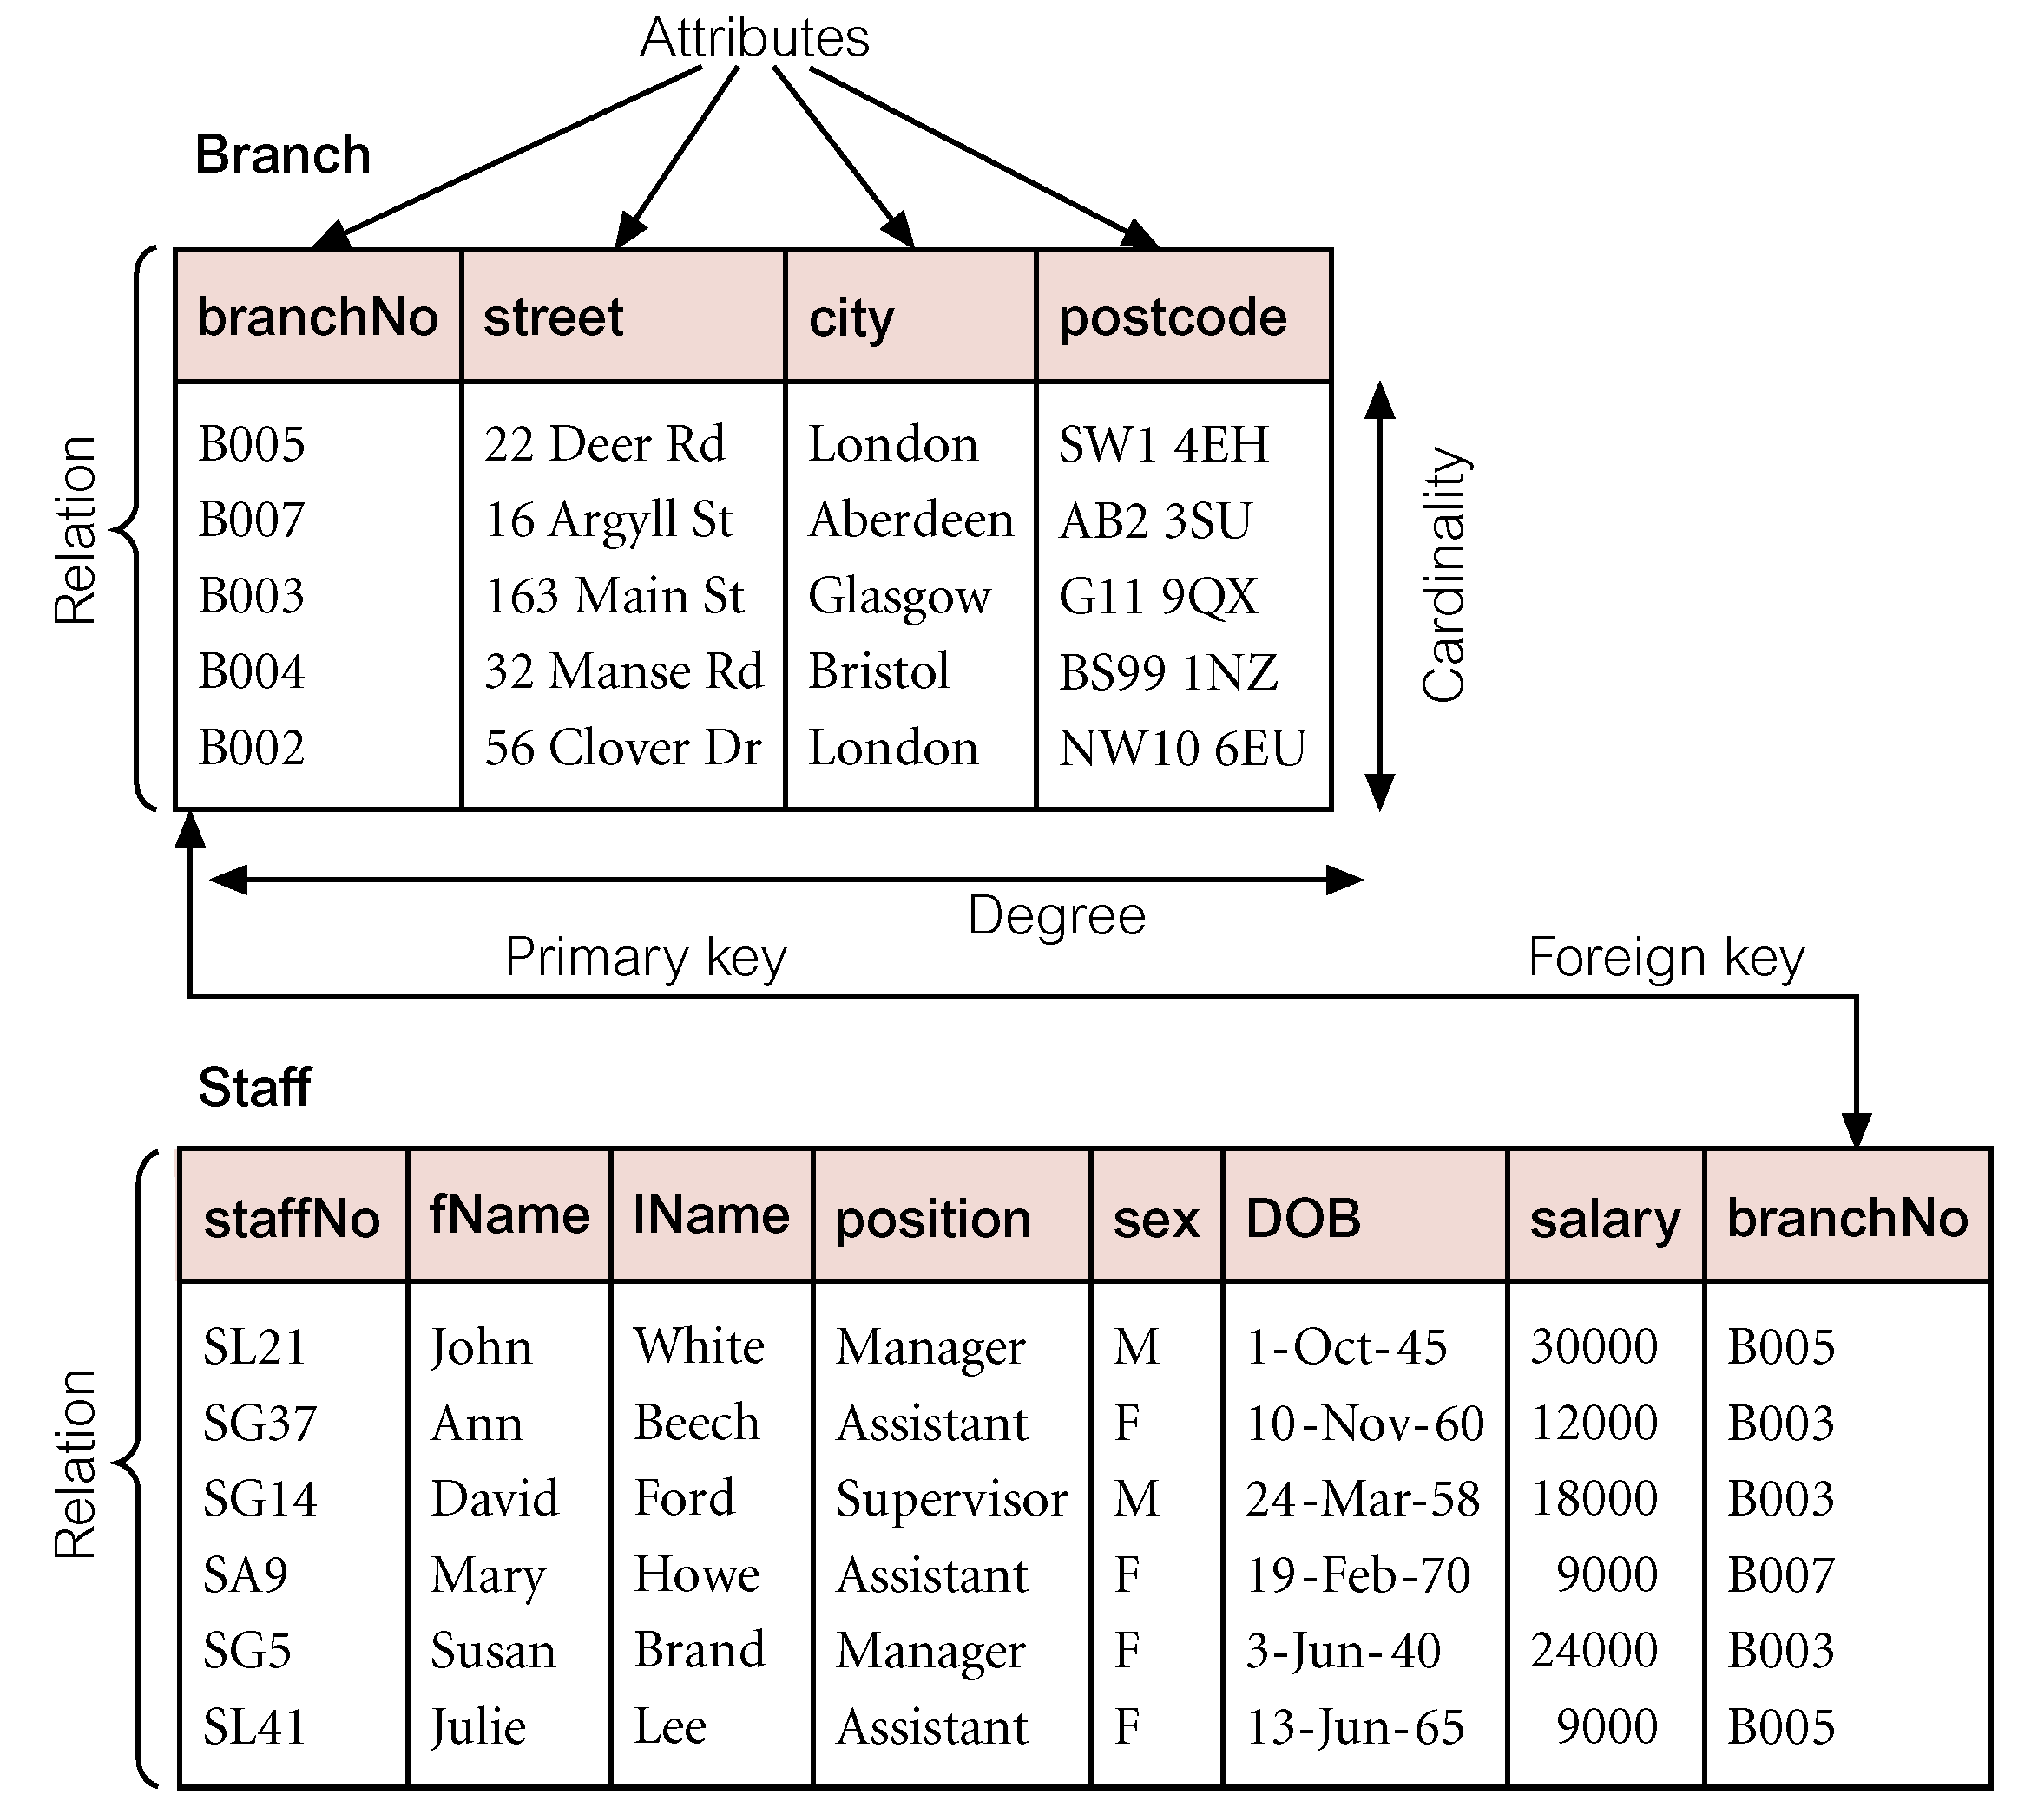
INSTANCES OF BRANCH AND STAFF (PART) RELATIONS
Introduction to Database Languages

Slide 29
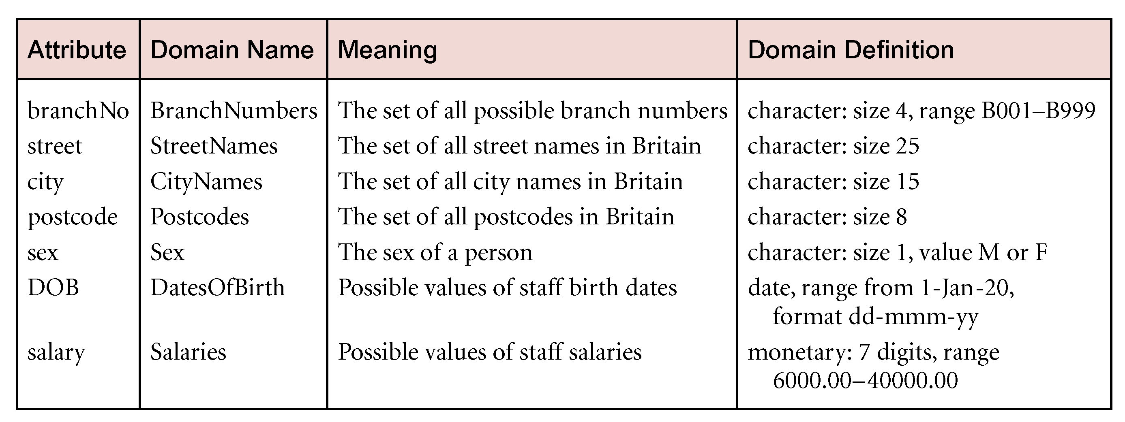
EXAMPLES OF ATTRIBUTE DOMAINS
Introduction to Database Languages

Slide 30
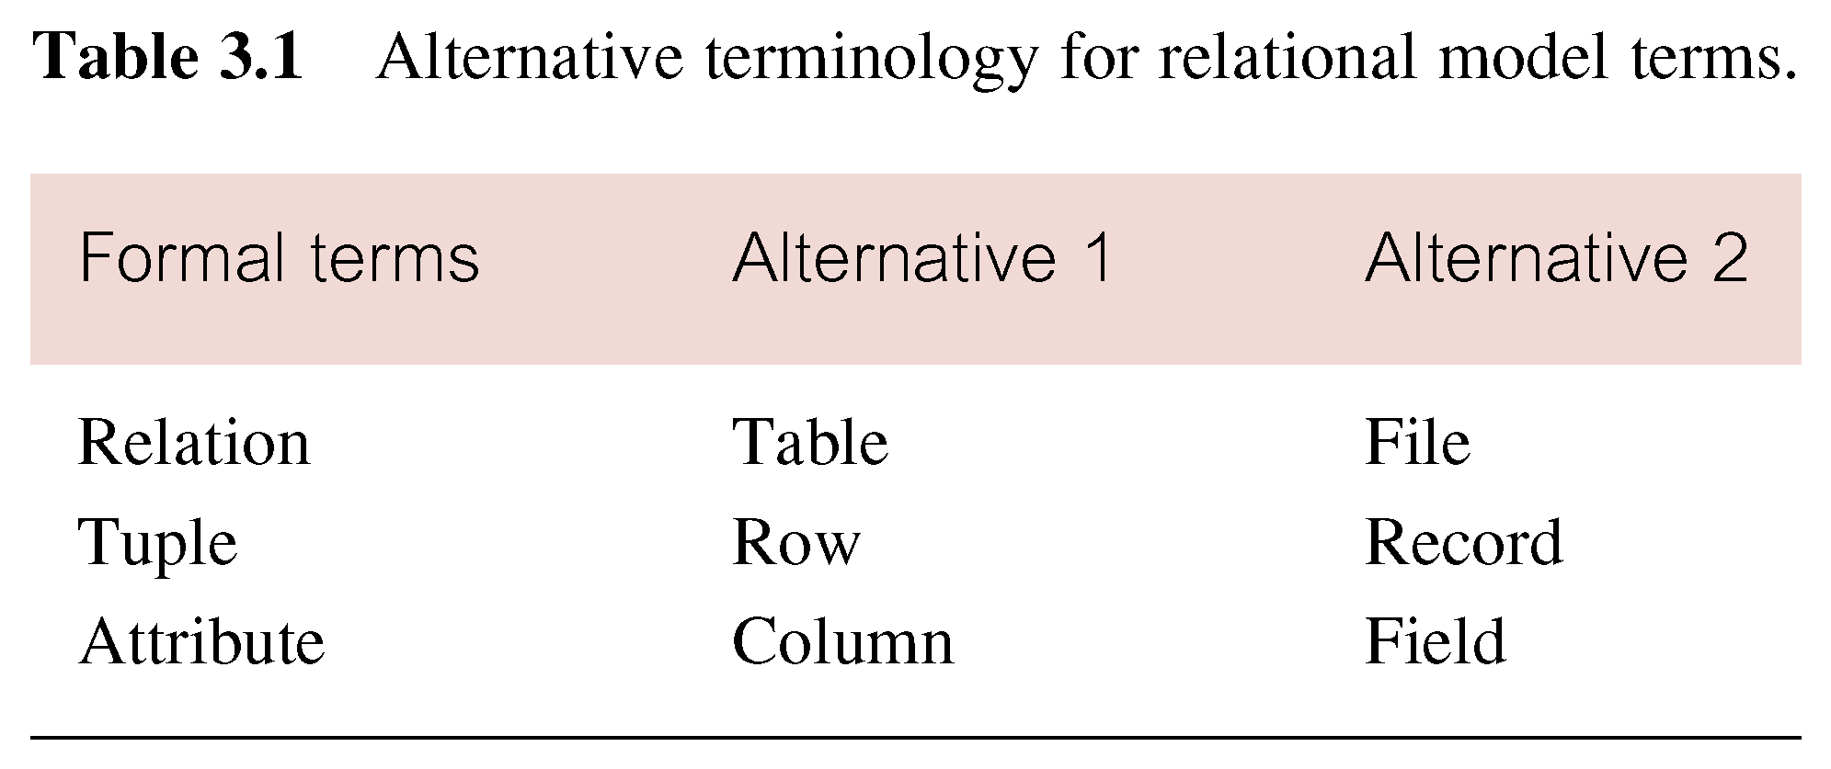
ALTERNATIVE TERMINOLOGIES FOR RELATIONAL MODEL
Introduction to Database Languages

Slide 31
RELATIONAL DATABASE CONCEPTS…
A relational database consists of tables that are appropriately structured.
Representation of a relational database schema for a company that stores information on;
  departments and employees.
  DEPARTMENT (DeptNo, DName, Loc)
  EMPLOYEES (EmpNo, EName, Job, Mgr, HireDate, Sal, Comm, DeptNo)
  .
Introduction to Database Languages

Slide 32
RELATIONAL DATABASE CONCEPTS…
  Data Constraints://constraints are set rules placed on a relation
    A department name value must never be repeated.
    No employee should earn a salary that is more than 5000
Introduction to Database Languages

Slide 33
PROPERTIES OF RELATIONS:
Uniqueness of relation names in a relational database schema.
A cell of a relation contains exactly one atomic (single) value.
Each column has a distinct name.
Order of attributes / tuples for a given relation is not significant
Values of an attribute are from the same domain.
Introduction to Database Languages

Slide 34
RELATIONAL INTEGRITY RULES
A data quality attribute to ensure that changes in a table are reflected to those that reference it
The first rule applies to the primary keys of base tables
Entity Integrity
  In a base relation, no attribute of a primary key can be null. (This is a correct statement: because a primary key may be formed of more than one attribute.)
The second rule applies to the FK
Referential Integrity
  If a foreign key exists in a relation, either FK value must match a PK value of some tuple in its home relation or FK value must be wholly null.
Introduction to Database Languages

Slide 35
DATABASE LANGUAGES
Programming languages, tailored and utilized to define a database, manipulate its content and query it.
Database Languages are known as data Sublanguages.
DBMSs have a facility for embedding the sublanguage in a high-level programming language e.g. C, C++, Java Or VB.
The high-level language is then known as a host Language.
Most data sublanguages also provide interactive commands that can be input directly from a terminal.
Introduction to Database Languages

Slide 36
DATABASE LANGUAGES...
A data sublanguage consists of two parts:
  Data definition Language (DDL)
Comprises those instructions used to create, remove and alter data structures for containing information
    Used to specify the database schema.
  Data Manipulation Language (DML)
Comprises those instructions used for retrieval, deletion, update & insertion of database contents
    Used to read and update the database.
Introduction to Database Languages

Slide 37
DATABASE LANGUAGES...
The data definition and data manipulation languages are not two separate languages;
They simply form parts of a single database language, such as;
  the widely used SQL language.

Slide 38
DATA DEFINITION LANGUAGE (DDL)
Allows the DBA or user to describe and name the;
  entities,
  attributes and
  relationships
required for the application, together with any associated integrity and security constraints
DDL is used to specify new database schemas
It is also used to modify exiting ones.
Introduction to Database Languages

Slide 39
DATA DEFINITION LANGUAGE (DDL)…
A database schema is a logical grouping of objects that belong to a user.
All created objects / structures are stored in a database schema
  tables, views, indexes.
Relation DB schema objects are created and maintained by using SQL DDL statements
  CREATE, ALTER, DROP.
The result of compiling DDL statements is a set of tables stored in special files -
1.<number>

Slide 40
DDL ...
  the system catalogue.
The system catalogue may also be referred to as a data dictionary.
The data dictionary integrates the meta-data;
  Definitive information about the structure is recorded in a data dictionary.
For example:
  definitions about the records, data items and other objects of interest to users or required by the DBMS.
Introduction to Database Languages

Slide 41
DDL CONT’D
The DBMS consults the data dictionary before accessing or manipulating the data.
The following statement in the SQL language defines the account table:
  create table account (account-number char(10), balance integer)
Execution of the above DDL statement creates the account table.
It updates a special set of tables called the data dictionary or data directory.
Introduction to Database Languages

Slide 42
DDL…
A data dictionary contains metadata— data about data.
The data values stored in the database must satisfy certain consistency constraints.
  For example, suppose the balance on an account should not fall below $100.
The DDL provides facilities to specify such constraints.
The database systems check these constraints every time the database is updated.

Slide 43
DATA MANIPULATION LANGUAGE (DML)
Provides a set of operations to support the basic data manipulation operations on the data in the database.
Some of the operations include:
  Insertion of new data into the database
  Modification of data stored in the database
  Retrieval of data contained in the database (Query language).
  Deletion of data from the database.
Introduction to Database Languages

Slide 44
DML CONT’D
There are basically two types:
Procedural DML
  Allows the user to tell the system what data is needed and how to retrieve the data;
  allows user to tell system exactly how to manipulate data.
Non-Procedural (Declarative)DML
  allows user to state what data is needed rather than how it is to be retrieved.
Examples of DML SQL statements;
  INSERT, UPDATE, DELETE and MERGE
Introduction to Database Languages

Slide 45
DML…
Declarative DMLs are usually easier to learn and use than are procedural DMLs.
Since a user does not have to specify how to get the data,
  the database system has to figure out an efficient means of accessing data.
The DML component of the SQL language is non-procedural.

Slide 46
DML…
The portion of a DML that involves information retrieval is called a query language.
  A query is a statement requesting the retrieval of information.
1.<number>

Slide 47
DATA DICTIONARY
A data dictionary: a DBMS component that stores the definition of data characteristics and relationships.
This “data about data” were labeled metadata.
The DBMS data dictionary provides the DBMS with its self describing characteristic.
The two main types of data dictionary exist,
  integrated and
  stand alone.

Slide 48
DATA DICTIONARY …
An integrated data dictionary is included with the DBMS
Relational DBMSs include a built in data dictionary or system catalog
This is frequently accessed and updated by the RDBMS.
Other DBMSs especially older types, do not have a built in data dictionary
The DBA may use third party stand alone data dictionary systems.

Slide 49
DATA DICTIONARY …
Data dictionaries can be classified as active or passive.
  An active data dictionary is automatically updated by the DBMS
  A passive data dictionary usually requires a batch process to be run to update it.
The data dictionary stores the description of all objects that interact with the database.

Slide 50
INFORMATION IN DATA DICTIONARY
There is no standard format for the information stored in the data dictionary
However, several features are common.
For example, the data dictionary typically stores descriptions of all:
Data elements that are defined in all tables of all databases.
  Specifically the data dictionary stores the name, datatypes, display formats, internal storage formats, and validation rules.

Slide 51
INFORMATION IN DATA DICTIONARY…
  It tells where an element is used, by whom it is used and so on.
Tables defined in all databases.
Indexes defined for each database table.
Defined databases:
  Who created each database, the date of creation, where it is located and who the DBA is.
End users and the Administrators of the data base
Programs that access the database

Slide 52
INFORMATION IN DATA DICTIONARY…
Access authorization for all users of all databases.
Relationships among data elements
Note:
  The users of the database normally don't interact with the data dictionary,
  It is only handled by the database administrators

